Slide 1
Open Source
Development Tooling
Prof. Dr. Dirk Riehle
Friedrich-Alexander University Erlangen-Nürnberg
FOSS B06
Notes:
It is Friedrich-Alexander University Erlangen-Nürnberg – FAU, in short.
Corporate identity wants us to say “Friedrich-Alexander University”.

Slide 2
Open Source and Innovation
Legal innovation
Process innovation
Software tool innovation
Business model innovation

Slide 3
Tooling Innovation
Software forges
Distributed version control

Slide 4
Software Forge
A software forge is ...
  A web-based tools platform for collaborative software development
  Typically not just for one, but for many open source projects
  Run as a service (though the forge software may be open source)

Slide 5







Open Source Software Forges

Slide 6
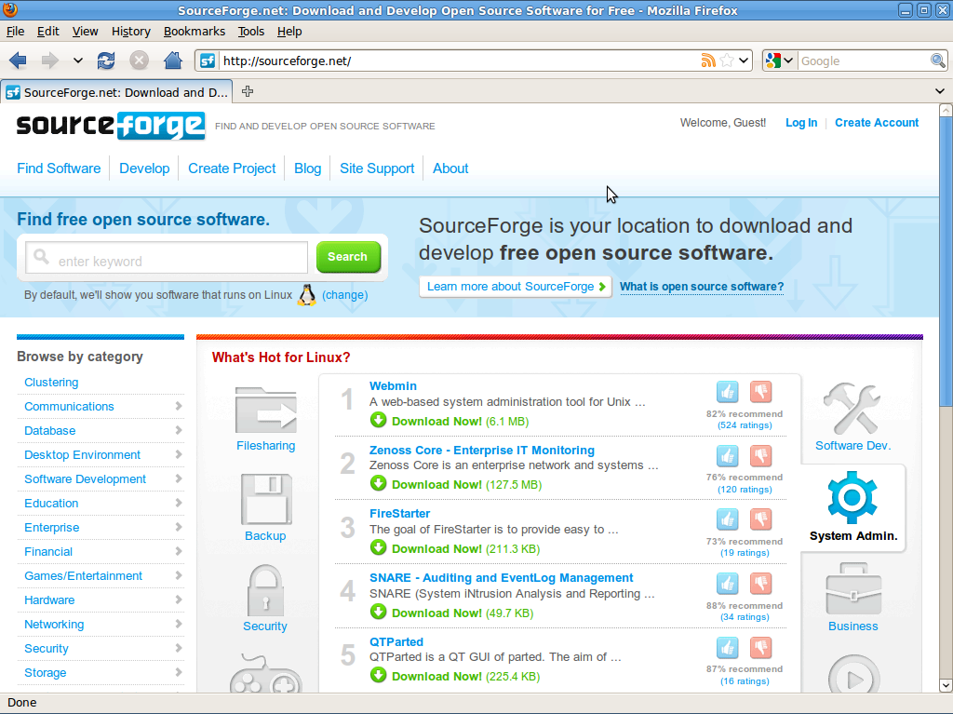
SourceForge

Slide 7
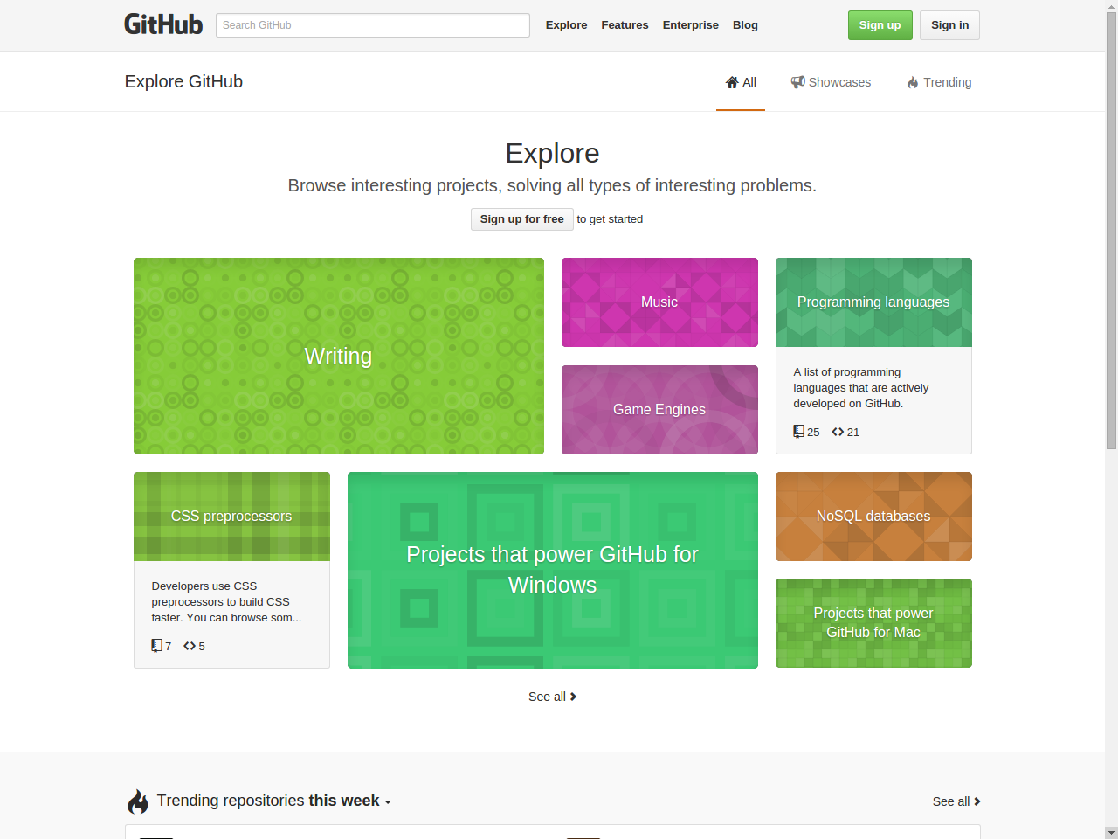
GitHub

Slide 8
Innovative Features
A forge helps
  Community process
  Improve code quality
  Shares best practices

Slide 9
The Five Stages of Volunteering (Recap)
# | Volunteer View | Project View
1 | Find project | Market project
2 | Understand project | Explain project
3 | Engage with project | Engage with volunteer
4 | Work within project | Work with contributor
5 | Lead project | Enable career

Slide 10
Forge Support for #1 Market Project
Support stumbling
  Random display of project
  Featured project of the week
Support searching
  Indexed search for keywords
  Hierarchical browsing

Slide 11
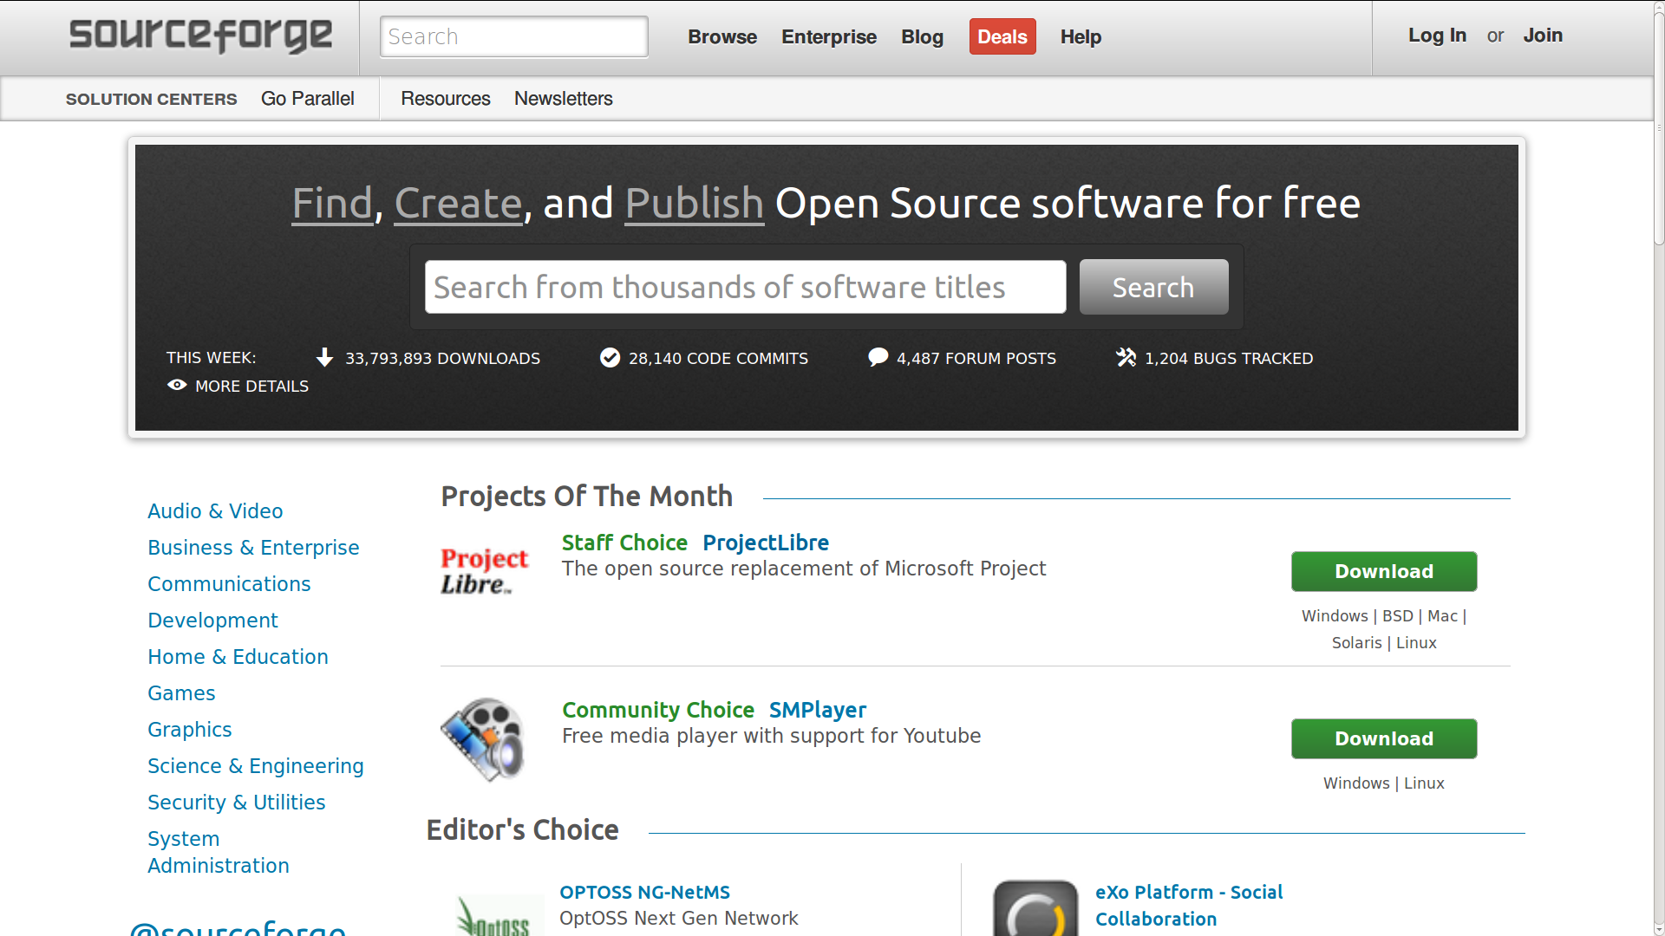

Slide 12
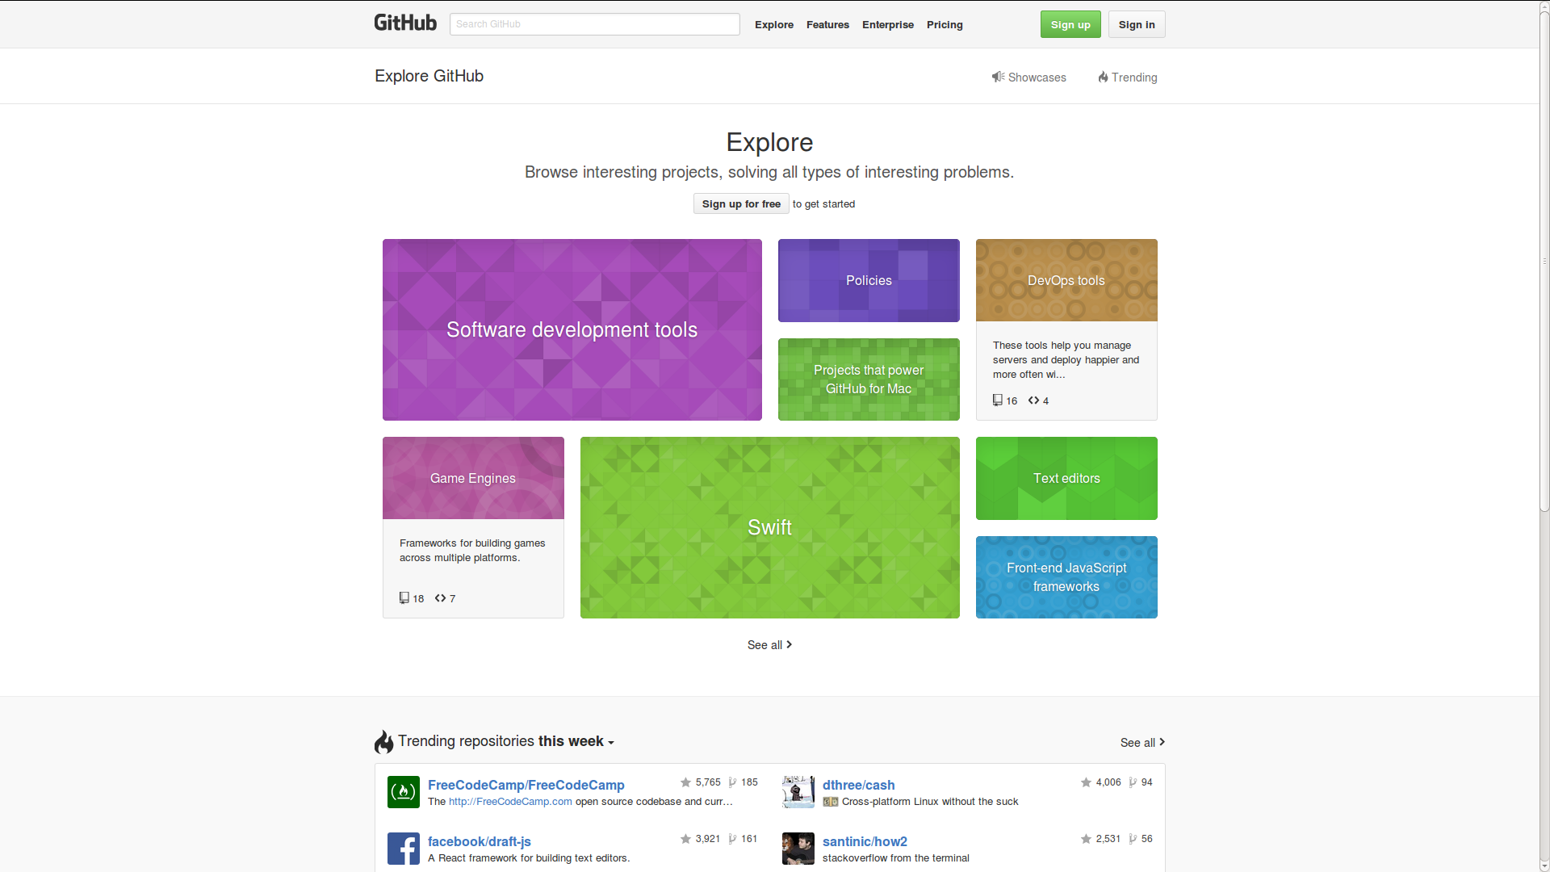

Slide 13
Forge Support for #2 Explain Project
Provide summary
  Project home page
Provide documentation
  Wikis and documentation download
Provide communication
  Forums and mailing lists

Slide 14
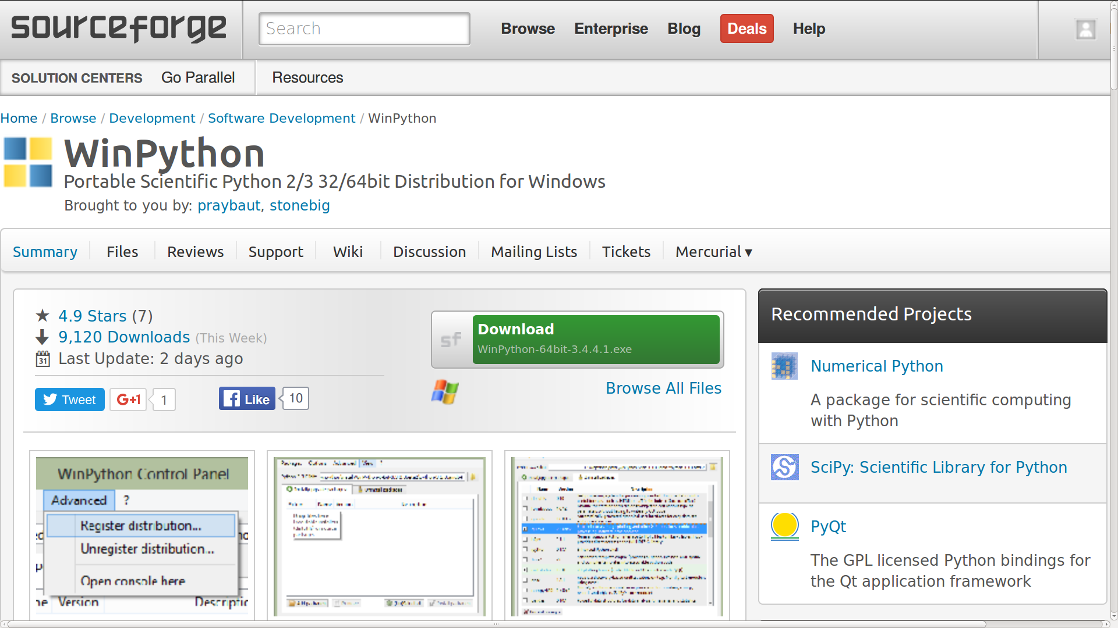
Example of a Project Homepage

Slide 15
Forge Support for #3 Engage with Volunteer
Provide installable download
Provide open forums and mailing lists
Provide all relevant tools open accessible

Slide 16
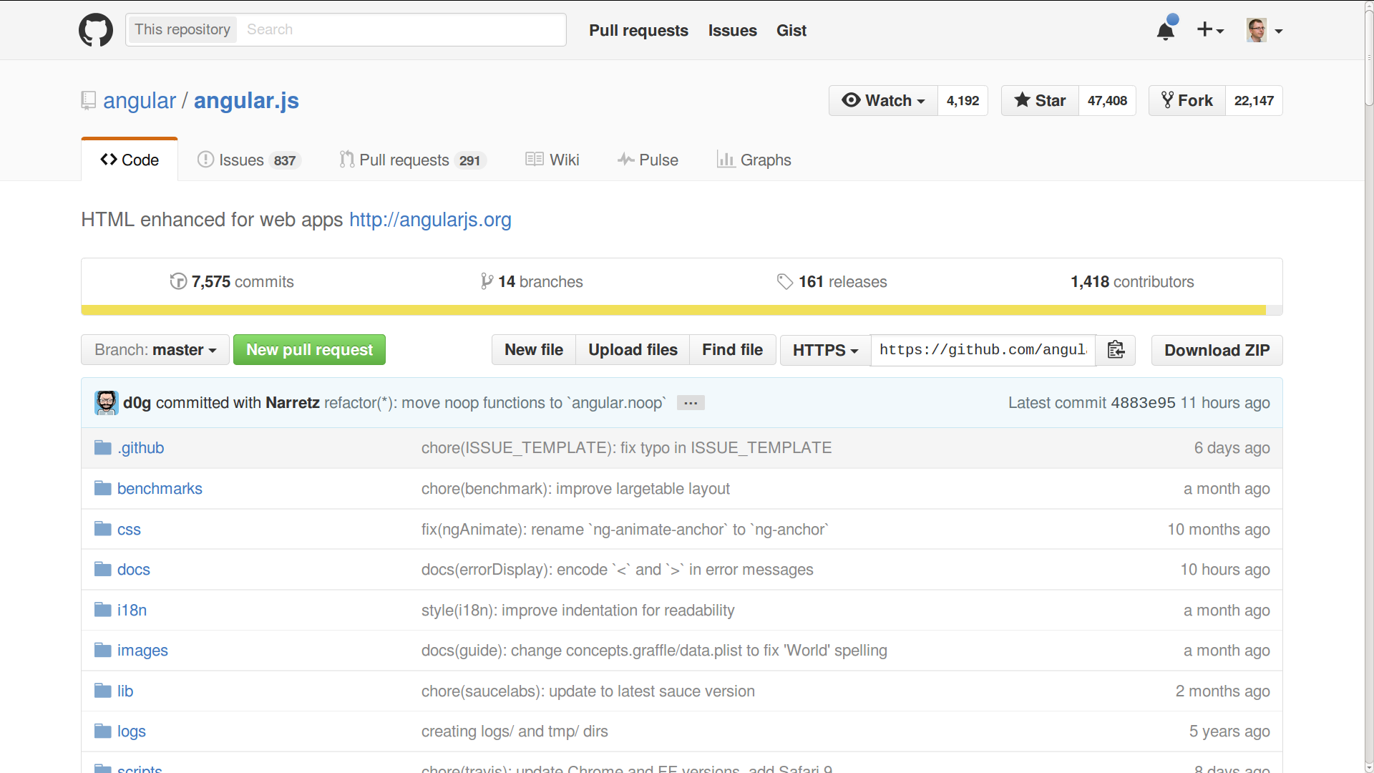

Slide 17
Forge Support for #4 Work with Contributor
Support email updates, notifications
Support forge persona, reputation building, kudos, etc.

Slide 18
Improves Code Quality
Quality of open source project improves, because
  There is less redundant, more shared development, because
    All projects are findable, co-located, never deleted

Slide 19
Shares Best Practices
Projects get better faster, because
  Co-location and spill-over help knowledge sharing

Slide 20
Distributed Version Control
git and hg changed how we develop software
Decoupling of efforts (“distributed”) speeds up development

Slide 21
Review / Summary of Session
Open source tool innovation
  Software forges
  Distributed version control
Software forges help
  The community process
  Improve code quality
  Share best practices
Distributed version control
  Speeds up development

Slide 22
Thank you! Questions?
dirk.riehle@fau.de – http://osr.cs.fau.de
dirk@riehle.org – http://dirkriehle.com – @dirkriehle
DR

Slide 23
Credits and License
Original version
  © 2012-2019 Dirk Riehle, all rights reserved
Contributions
  ...

